Slide 1
Vendor Management System .
What have we established
All established companies have a VMS basis their needs and size
Onboarding is an issue that is marred with friction to unaligned motives along with process & platform handoffs
Large Conglomerate ecosystems player like SAP & Oracle etc, Other player use some of the modern platform like Aerchain, Zycus etc.
Vertical Ideas
Lateral Ideas
Speed up Onboarding
Bring Parallelism in the approval process
Create a risk based Tiered approval depth process (vendor type, scale of project, allowed SOW value, data sensitivity )
Introduce guardrails in the system to prevent fraud
Can we build for an underserved industry ?
Beyond the parties already present on the systems who else need to be involved
who is the invisible in this entire process !!

Slide 2



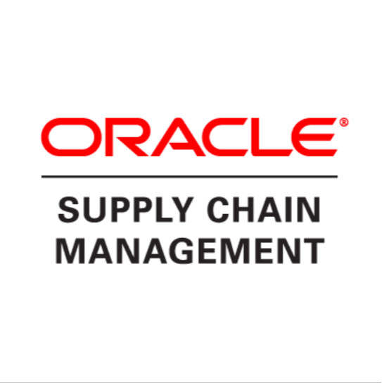





VMS across Industry In General .
Large Organization
Fortune 500s , CMMI Level 5
Large Established vendors
Mid Level vendors
Referred to as contractors
Entry Level Vendors
Referred to as Sub contractors
A Typical Company with less thank 300 employees generally across IT, Manufacturing, Heavy industries etc
Entry level players less thank 50 people that are not able to work directly with large established player
Infosys
TCS
[ Whitespace ]
Other established Vendor across IT , Manufacturing, etc
Indigenous
Solutions
Nothing Exists here

Slide 3




VMS across Industries : Heavy Engineering .
Major Heavy Industries
Contractors
Sub Contractors
Larger Players
[not the target ]
Smaller players
No discoverability on what opportunities are available
Very limited protections
Small to medium engineering firms
No discoverability to find the best specialist firm or find the best bid
Limited way to enforce contracts
[ Whitespace ]
Nothing Exists here
This does not usually happen – Large companies do not onboard smaller companies

Slide 4
VMS to formalize Contractor & Sub Contractor Interactions.
Problem | Solution
How do Contractors & Sub – Contractors find each other | Marketplace of trusted sub contractors helping them build a history of work
Formalize onboarding | Onboarding is at a platform level saving critical time
No central document repository | All Contracts & document Assets are managed centrally
Trust in network | Any Fraud and malpractice by either of the parties in the network triggers notification / warnings across network

Slide 5
Trust Quantified
Portable Trust
Identity
Capability
Reputation
Continuous verifications
Verified Identities of company Directors
PAN /GST /CIN Information
Number of registered offices
Company Beneficiaries & promoters
Bank Details
Projects completed
Largest historic contract value
Number of contracts
Industries served
Certifications
Manpower / Employees
Assets & Machineries
Tech Stack
Average response SLA
Working Capital
Liabilities & Debt
Renewal rate ( benchmarked as per industry)
Repeat orders ( benchmarked as per industry)
Dispute frequency
Legal notices
Audit Frequency
Verifiable Testimonials
Proof of renumeration to employees ( EPFO)
Insurance details
Revalidate PAN,GST CIN & Bank Details continuously using Govt provide APIs & Systems
Periodic check-in with client by the platform on performance & general conduct
Period verification of any legal implication on directors & organization

